Slide 1

Beecher Hills Elementary School
Notes:
Good Morning/Afternoon! Today we begin the process of planning our school’s budget for FY20. I know we are all here for the same reason and that is ensuring success for all (enter school name) students. This meeting is to provide an overview of the draft budget and for you to give feedback on the draft budget.

Slide 2
Norms
This is a meeting of the GO Team. Only members of the team may participate in the discussion. Any members of the public present are here to quietly observe.
We will follow the agenda as noticed to the public and stay on task.
We invite and welcome contributions of every member and listen to each other.
We will respect all ideas and assume good intentions.

Slide 3

GO Team Budget Development Process
YOUR SCHOOL STRATEGIC PLAN…
is your roadmap and your role. It is your direction, your priorities, your vision, your present, your future.
Step 1: Data Review
Step 2: Strategic Plan Review
Step 3: Budget Parameters
Step 4: Budget Choices
Notes:
Today I will provide an overview of the budget allocations for FY20. We will begin the work of funding the strategic priorities we agreed upon during our strategic review meeting. (IF YOU HAVE NOT DECIDED ON YOUR PRIORITIES, YOU WILL SAY – WE WILL DECIDE ON OUR PRIORITIES AND THEN DISCUSS ALLOCATING FUNDS TO ADDRESS THOSE PRIORITIES).

Slide 4
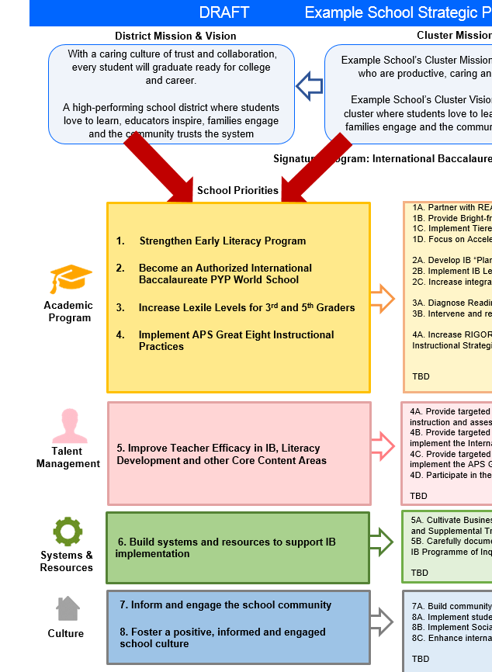
FY20 Budget Development Process
Principal’s Role
Design the budget and propose operational changes that can raise student achievement
Flesh out strategies, implement and manage them at the school level
Focus on the day-to-day operations
Serve as the expert on the school
Hire quality instructional and support personnel
The GO Team’s Role:
Focus on the big picture (positions and resources, not people)
Ensure that the budget is aligned to the school’s mission and vision and that resources are allocated to support key strategic priorities

Slide 5
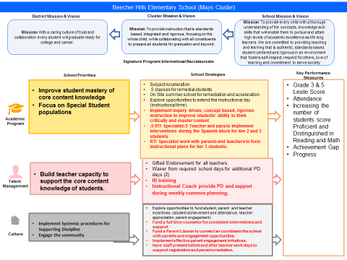

Beecher Hills Strategic Plan
Example
Notes:
You should have a copy of our updated strategic plan (please make copies to be distributed to team).

Slide 6
FY20 Priorities & SMART Goals
School Priorities
SMART Goals
Improve student mastery of core content knowledge
40% of Beecher Students will perform at the Proficient or better level by May 2022 as measured by the GMAS and STAR standardized assessments.
Build teacher capacity to support the core content knowledge of students.
40% of Beecher Students will perform at the Proficient or better level by May 2022 as measured by the GMAS and STAR standardized assessments.

Slide 7
FY20 Budget Parameters
FY20 School Priorities | Rationale
Improve student mastery of core content knowledge | We have achieved maximum points in CCRPI for growth and closing the achievement gap. We want to now move to ensure students are achieving at higher levels.
Focus on Special Student populations | We still want to ensure we are doing that work that causes growth in struggling learners, we also want to ensure we are providing resources that causes higher achievement in students who have met minimum requirements.
Build teacher capacity to support the core content knowledge of students. | Our research and data reviews acknowledge the different strategies needed for growing struggling learners and increasing achievement in students who have mastered the minimum. We want to ensure all teachers have capacity in both.
Engage the community | APTT has been our family engagement model. It’s focus is on essential skills. We want to continue that but include/add strategy that will be appropriate for our goal of increasing achievement of learners approaching or achieving proficiency.
Notes:
Discuss priorities and rationale. After you have gone over the priorities and rationale – ask GO Team if this represents what was agreed upon.
Are there any priorities I left off?
Are there any questions or concerns?
The next time we meet, I will show you how I have allocated resources to support our strategic priorities.

Slide 8
Discussion of Budget Summary
(Step 4: Budget Choices)

Slide 9
Executive Summary
This budget represents an investment plan for our school’s students, employees and the community as a whole.
The budget recommendations are tied directly to the school’s strategic vision and direction.
The proposed budget for the general operations of the school are reflected at $3,844, 520
This investment plan for FY20 accommodates a student population that is projected to be 270 students, which is a decrease of 48 students from FY19.
Notes:
Here’s a few highlights for our budget this year – read executive summary

Slide 10
School Allocation
FY2020 TOTAL SCHOOL ALLOCATIONS
School | Beecher Hills Elementary School
Location | 3051
Level | ES
FY2020 Projected Enrollment | 270
Change in Enrollment from FY2019 | -48
Total Earned | $ 3,844,520
SSF Category | Count | Weight | Allocation
Base Per Pupil | 270 | $4,420 | $ 1,193,321
Grade Level
Kindergarten | 51 | 0.65 | $ 146,513
1st | 38 | 0.30 | $ 50,385
2nd | 45 | 0.30 | $ 59,666
3rd | 49 | 0.30 | $ 64,970
6th | 0 | 0.05 | $ -
9th | 0 | 0.00 | $ -
Poverty | 158 | 0.55 | $ 384,073
EIP/REP | 84 | 1.05 | $ 389,818
Special Education | 49 | 0.03 | $ 6,497
Gifted | 16 | 0.60 | $ 42,429
Gifted Supplement | 0 | 0.60 | $ -
ELL | 1 | 0.15 | $ 663
Small School Supplement | 180 | 0.40 | $ 318,219
Incoming Performance | 49 | 0.10 | $ -
Baseline Supplement | Yes |  | $ 20,449
Transition Policy Supplement | No |  | $ -
Total SSF Allocation |  |  | $ 2,715,455
Additional Earnings
Signature |  |  | $ 232,000
Turnaround |  |  | $ -
Title I |  |  | $ 162,000
Title I Holdback |  |  | $ (16,200)
Field Trip Transportation |  |  | $ 7,103
Dual Campus Supplement |  |  | $ -
District Funded Stipends |  |  | $ 7,200
Total FTE Allotments | 10.75 |  | $ 736,963
Total Additional Earnings |  |  | $ 1,129,065
Total Allocation |  |  | $ 3,844,520
Notes:
For FY20, APS is continuing to increase equity within the District and the flexibility principals have in regards to our schools budgeted funds. The new Student Success Funding Model (SSF) allocates dollars to schools based on the number of enrolled students and receives a funding "weight" based on need. This year, student characteristics were weighted based on:
Grade Level –
K
1st through 3rd
6th
9th
Poverty – Weighted for all Direct Certification enrolled students.
Beginning Performance – Weighted Middle School and High School students entering with beginner’s performance on milestones.
ESOL – Weighted for all ESOL designated students in order to supplement due to ESOL staff being locked.
Special Education - Weighted for all Special Education students.
Gifted – Weighted and measured by number of students in the Gifted Program
Small School Supplement – Weighted for low enrollment schools
ES – 500
MS – 600
HS – 700
As you can see, our projected enrollment for FY19 is _______, we increased/decreased by __________ from last year.
We received the following weights for our student characteristics: (Below is just for the script, principals need to insert their school’s characteristics)
Grade Level
Poverty
Special Education
Gifted
Gifted Supplement
ELL
Small School Supplement

Slide 11
Budget by Function (Required)
Notes:
I am passing out the definitions for these funding categories. You will see what makes up each category. Although the total amount will not change, allocation per function may depending on our conversations and school needs.

Slide 12
Budget by Function (Required)
Notes:
Explain the pie chart and allocations

Slide 13
What’s Next?
January:
  GO Team Initial Budget Session (Jan. 22nd-31st)
February:
  One-on-one Associate Superintendent discussions
  Cluster Planning Session (positions sharing, cluster alignment, etc.)
  Program Manager discussions and approvals
  GO Team Feedback Session (??????)
  HR Staffing Conferences (February 25th - March 1st)
• March:
  Final GO Team Approval (March 12th )
Notes:
In February, we will meet again to discuss how the school’s budget has been allocated to support the programmatic needs and FY20 key strategic priorities.
If think we need to continue our budget conversations, we will schedule additional meetings. My goal is to make sure your voices are reflected in our school’s budget.
I will also be meeting with my Associate Superintendent, program managers and other key leaders to go over our budget and to make sure the school is meeting the standards of service and appropriately staffing.
During the week of Feb. 25th -March 1st , HR Staffing Conferences will be held. At this meeting, I will present my plan for staff utilization, resource distribution and plan for staffing implications.
We will need to approve the budget at the ________ meeting.

Slide 14

Questions?
Thank you for your time and attention.
Notes:
IF YOU FEEL YOUR TEAM IS READY TO APPROVE THE DRAFT BUDGET, PLEASE DO SO. PLEASE REMIND THEM THAT YOU MAY NEED TO MEET WITH THEM AGAIN, IF THERE ARE CHANGES FROM YOUR MEETINGS WITH DISTRICT LEADERSHIP. LET THEM KNOW YOU WILL KEEP THEM INFORMED!!

